Slide 1


Slide 2
Kampiun name
World Vision

Slide 3
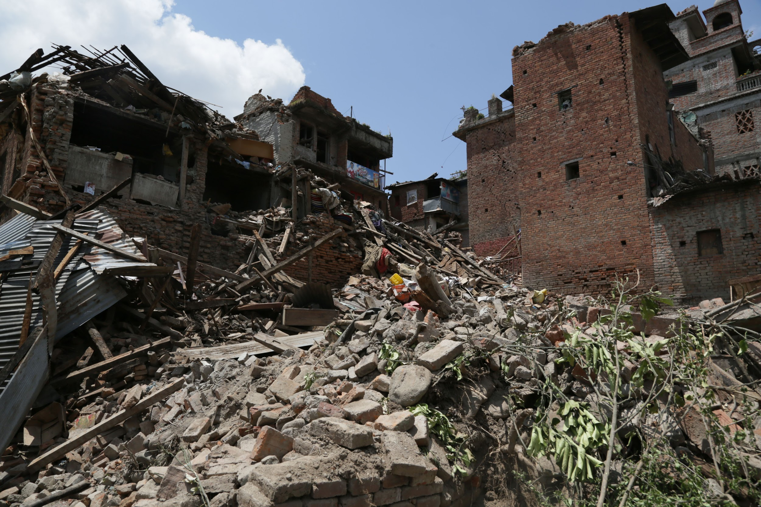

Slide 4
Problem
Donation
?
Help

Slide 5
Bottlenecks
Time
Uncertainty

Slide 6
Possible Solution
Disaster Early Warning
Funding
PREDICT

Slide 7
Possible Solution
Disaster Early Warning
Funding
PREDICT
SAVES A LOT OF VALUABLE TIME

Slide 8
Implementation
Disaster Early Warning
Funding
PREDICT
Impact Prediction
Funding Prediction

Slide 9
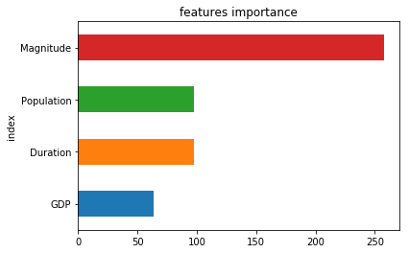
Impact Prediction
Datasets:
Disaster Database (EM-DAT)
Floods, storms, and earthquakes
World Bank Database
Result:
Large MSE (XGBoost)
Country specific data is more accurate

Slide 10
Funding Prediction
Datasets:
Disaster Database (EM-DAT)
Floods, storms, and earthquakes
UN Financial Tracking Service

Slide 11
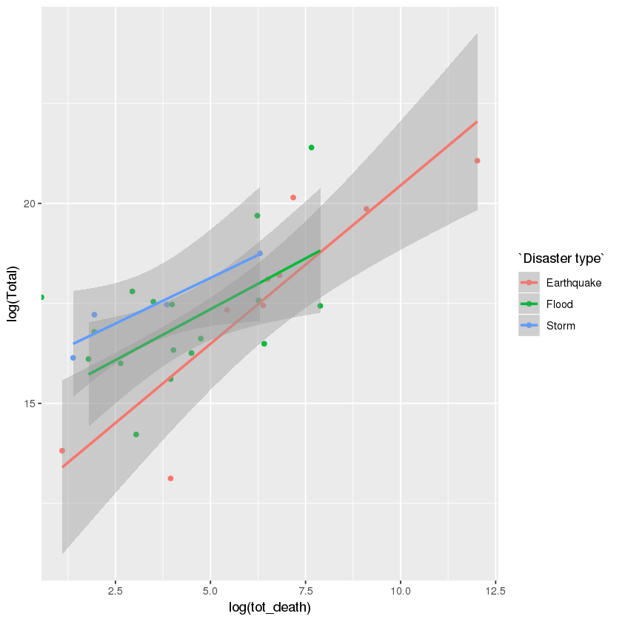
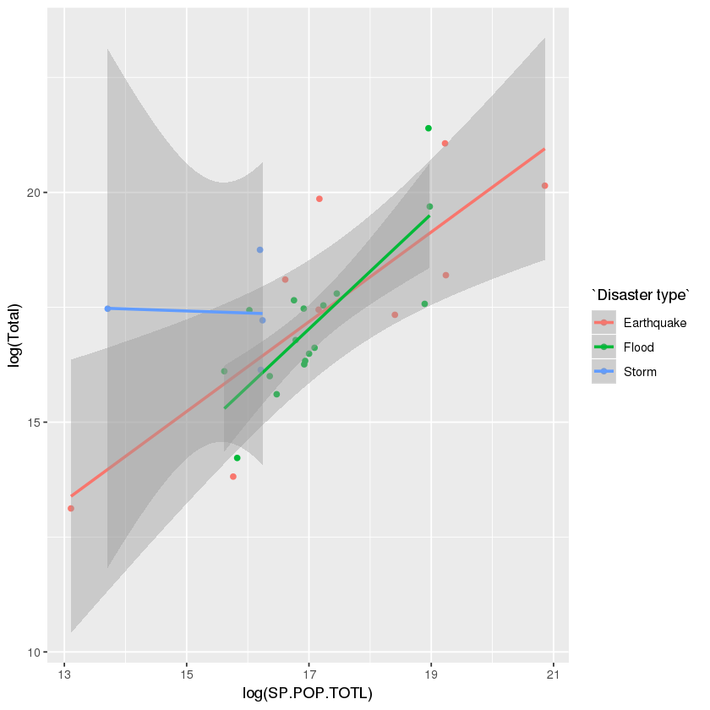
There might be correlation among the variables

Slide 12
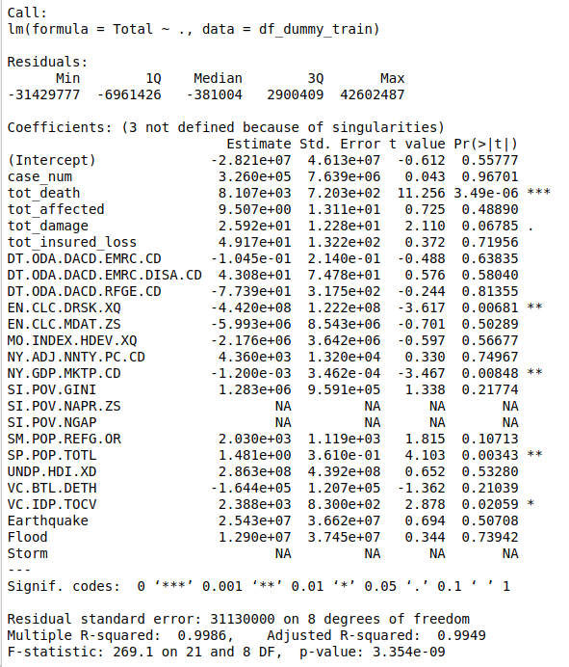
Only few variables has a significantly statistical effect on Total budget
a) tot_death
b) #population
c) Droughts, floods, extreme temps
d) GDP
e) Internally displaced persons
99.5% R-squared with linear regression
small dataset (only 38 records)

Slide 13
